Slide 1

Hang in there…we’re starting soon

Slide 2

BIML-UP!! How I use BIML to speed up SSIS development
by Martin Schoombee

Slide 3


BIML-UP!!
Photo by Alex Sheldon on Unsplash
How I use BIML to speed up SSIS development
by Martin Schoombee

Slide 4

About Me
“I help people make sense
of their data”
My blog: martinschoombee.com
My company: 28twelve.consulting
Tweet me: @MartinSchoombee
GitHub Repo: https://github.com/mschoombee/Presentations/wiki/Presentations

Slide 5
Agenda
What is BIML
Reasons to use BIML
BIML basics
How I use BIML

Slide 6

BIML Who?
Notes:
Interact

Slide 7
Markup Language
<html>
<title>Hello World!</title>
<body>
<p>This is a paragraph…</p>
</body>
</html>

Slide 8
Markup Language - Tags
<html>
<title>Hello World!</title>
<body>
<p>This is a paragraph…</p>
</body>
</html>

Slide 9
Markup Language – Human Readable
<html>
<title>Hello World!</title>
<body>
<p>This is a paragraph…</p>
</body>
</html>

Slide 10
Markup Language - Properties
<html>
<title style=“color:blue;”>Hello World!</title>
<body>
<p>This is a paragraph…</p>
</body>
</html>

Slide 11
BIML
<Biml xmlns=“http://schemas.varigence.com/biml.xsd”>
<Packages>
<Package Name=“Load Some Data”>
…
<Package>
</Packages>
</Biml>

Slide 12

Why BIML?
Photo by Camylla Battani on Unsplash
Notes:
There are many reasons to use BIML, but let’s look at a very obvious one to start…
Demo 1 – How many clicks to change the “Rows per batch” and “Maximum insert commit size” properties of a data flow destination?

Slide 13
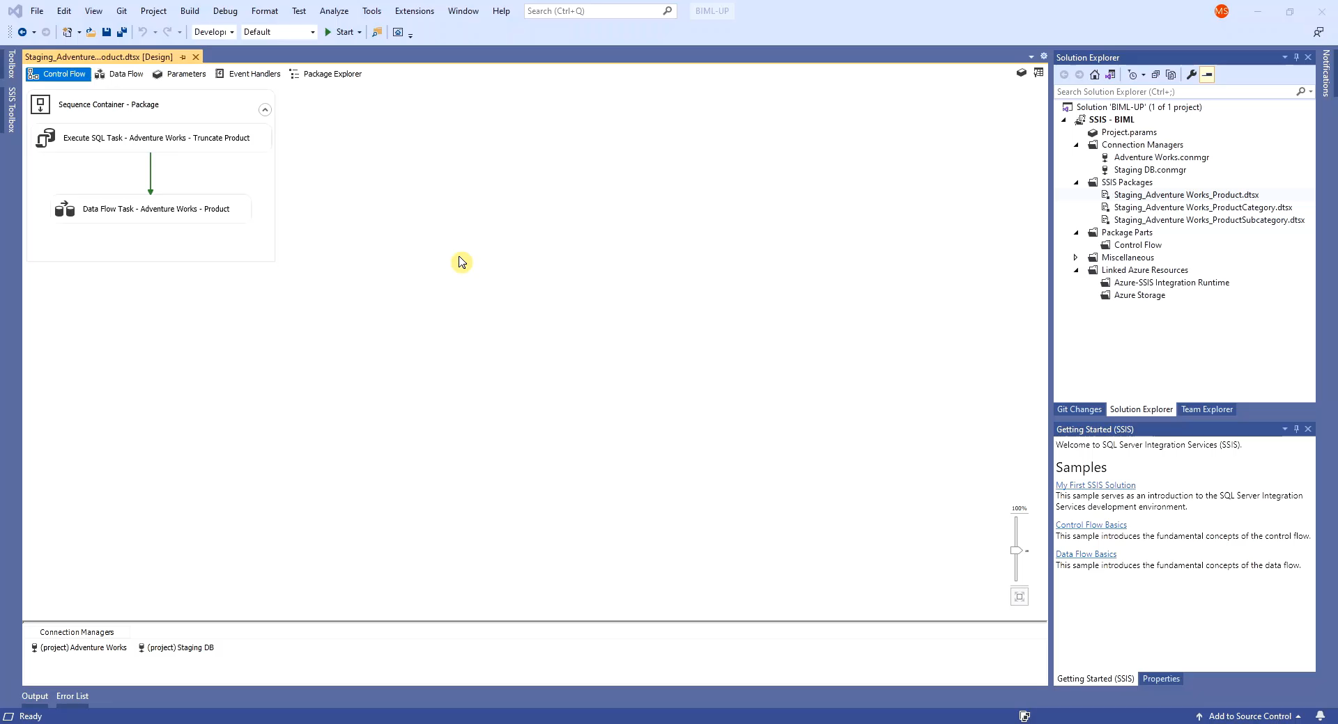
Notes:
Demo 1 – How many clicks to change the “Rows per batch” and “Maximum insert commit size” properties of a data flow destination?

Slide 14
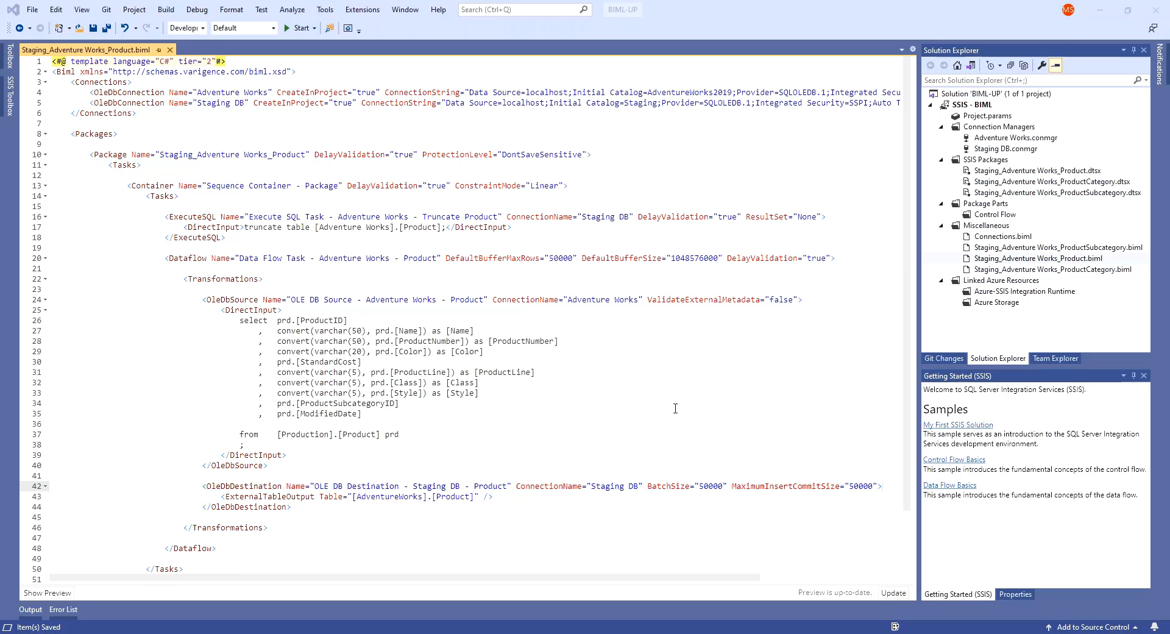
Notes:
Demo 1 – How many clicks to change the same properties in BIML?

Slide 15

Reasons to BIML
Photo by Clem Onojeghuo on Unsplash

Slide 16
Reasons to BIML
Save your mouse…and your sanity!!

Slide 17
Reasons to BIML
Save your mouse…and your sanity!!
Enforce coding standards

Slide 18
Reasons to BIML
Save your mouse…and your sanity!!
Enforce coding standards
Source control

Slide 19
Reasons to BIML
Save your mouse…and your sanity!!
Enforce coding standards
Source control
Automation

Slide 20

BIML Basics
Photo by Glen Carrie on Unsplash
Notes:
Varigence website and BIML Express download
Demo:
Walk through Staging_Adventure Works_Product package and BIML script to show syntax
Show directives and hierarchical (tiered) files and execution
Show include files
Show Root Node
Show automation with C# to generate all packages

Slide 21

Build a Framework
Photo by pine watt on Unsplash
Notes:
Most people will use BIML to create an ETL framework…

Slide 22
A typical ETL framework
Connect to data source
Photo by pine watt on Unsplash

Slide 23
A typical ETL framework
Connect to data source
Extract metadata (tables, fields, etc.)
Photo by pine watt on Unsplash

Slide 24
A typical ETL framework
Connect to data source
Extract metadata (tables, fields, etc.)
Use BIML to generate staging packages
Photo by pine watt on Unsplash

Slide 25

I’m not “most people”…
Photo by yns plt on Unsplash
Notes:
At the same time I realized that I’m not “most people”. When I build a data warehouse, there are some things I need…or don’t

Slide 26
Why am I different?
Don’t want all source tables
Want a subset of attributes
May need to change data types
Photo by yns plt on Unsplash

Slide 27

Ok, I’m not that different
Photo by Charles Deluvio on Unsplash
Notes:
Ok, I’m not that different…most people would want this, but the question is how? Or what would be the best way to do this?

Slide 28
My ETL development process
Identify source system(s)
Notes:
Looking at my own process a little closer…

Slide 29
My ETL development process
Identify source system(s)
Identify source attributes

Slide 30
My ETL development process
Identify source system(s)
Identify source attributes
Create staging tables

Slide 31
My ETL development process
Identify source system(s)
Identify source attributes
Create staging tables
Develop staging SSIS packages

Slide 32
My ETL development process
Identify source system(s)
Identify source attributes
Create staging tables
Develop staging SSIS packages
Oops, I forgot something!

Slide 33
My ETL development process
Identify source system(s)
Identify source attributes
Create staging tables
Develop staging SSIS packages
Oops, I forgot something!
Back to step 2 (x 10)…

Slide 34
My ETL development process
…
Develop fact table procedures
Oops, I forgot something!
Notes:
Or if we look at the broader process, sometimes you get further down the line and then this happens…

Slide 35
My ETL development process
…
Develop fact table procedures
Oops, I forgot something!
Back to step 2 (x 20)…

Slide 36
My ETL development process
…
Show new report to end user
Notes:
Or even worse…

Slide 37
My ETL development process
…
Show new report to end user
User wants another measure

Slide 38
My ETL development process
…
Show new report to end user
User wants another measure
Oops, I need a new source attribute!

Slide 39
My ETL development process
…
Show new report to end user
User wants another measure
Oops, I need a new source attribute!
Back to step 2 (x 100)

Slide 40

Photo by Jared Rice on Unsplash
Notes:
And before you know it, you feel (and look) like this…

Slide 41

In a perfect world…
Script tables
Photo by Thomas Park on Unsplash
Notes:
In a perfect world, I need my ETL framework to do the following…

Slide 42
In a perfect world…
Script tables
Generate staging packages
Photo by Thomas Park on Unsplash

Slide 43
In a perfect world…
Script tables
Generate staging packages
Generate parent packages
Photo by Thomas Park on Unsplash

Slide 44
In a perfect world…
Script tables
Generate staging packages
Generate parent packages
Reduce impact/risk
Photo by Thomas Park on Unsplash

Slide 45
In a perfect world…
Script tables
Generate staging packages
Generate parent packages
Reduce impact/risk
Speed up development
Photo by Thomas Park on Unsplash

Slide 46
In a perfect world…
Script tables
Generate staging packages
Generate parent packages
Reduce impact/risk
Speed up development
Assist with documentation
Photo by Thomas Park on Unsplash

Slide 47

Photo by Alessandro Bianchi on Unsplash
Notes:
And then I had a lightbulb moment…

Slide 48

Demo time…
Notes:
Show source-to-target mapping document
Show BIML to script tables & packages

Slide 49
About Me
“I help people make sense
of their data”
My blog: martinschoombee.com
My company: 28twelve.consulting
Tweet me: @MartinSchoombee
GitHub Repo: https://github.com/mschoombee/Presentations/wiki/Presentations

